Slide 1

Mini Project 1
Jay Bryan M. Flores
Notes:
To use this title animation slide with a new image simply 1) move the top semi-transparent shape to the side, 2) delete placeholder image, 3) click on the picture icon to add a new picture, 4) Move semi-transparent shape back to original position, 5) Update text on slide.

Slide 2
PROBLEM
People who are suffering from Mental Health Diseases and seeking help on how to deal about it (Depression/Anxiety)
People who wants to have a safe space/place where they could freely express themselves and listen to other’s life experiences since the world we live in is filled with judgement and negativity.

Slide 3
SOLUTION
Inspire and encourage everyone to share their triumphs over problems encountered to be able to help other people keep on keeping on.
Compile videos/blogs/vlogs that could help every person deal with depression/anxiety in the Philippines
Engage in positive discussions through the forum to be created on the website as this will serve as our safe space where we are free to express ourselves in a respective and positive manner
What story do you want to tell?

Slide 4
Project Objective
A website that could help people who are struggling mentally and emotionally and be a reminder that every person can conquer anxiety and depression.

Slide 5
People with Anxiety Attacks and Depression as well as schizophrenic persons.
TARGET AUDIENCE

Slide 6
INTRODUCTION
1
2
3
Anxiety is no laughing matter and should never be brushed over.
The WHO estimated that 154 million Filipinos suffer from depression, 1 million from schizophrenia, and 15.3 million from substance use disorders, while 877,000 die due to suicide every year (Department of Health, 2018).
Thus, mental disorders could greatly affect employment and levels of education, most especially in ages 25 to 52 years (Hakulinen et al., 2019).
Reference : The basics you can find anywhere 5 Steps To Successful Storytelling Published on April 5, 2014 Featured in: Marketing & Advertising

Slide 7
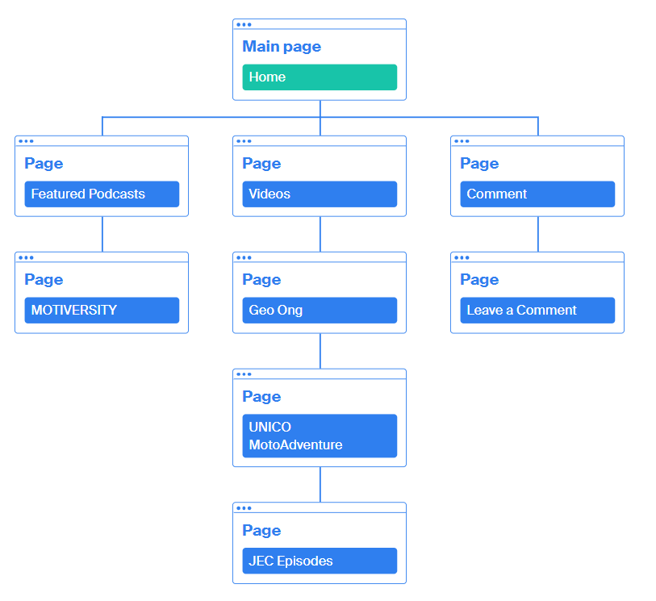
Site Map

Slide 8
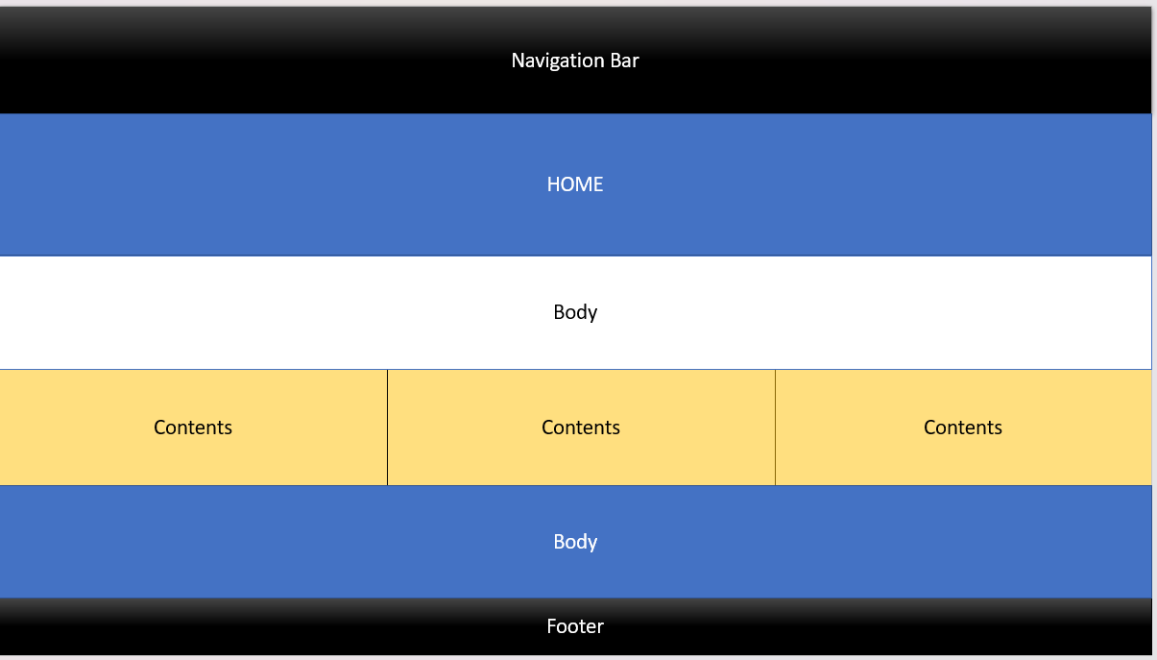
WIREFRAME

Slide 9
End of Presentation
THANK YOU
Neal Creative | click & Learn more

